Slide 1


DTV - Security Pipeline
November 2020

Slide 2












Architecture

Slide 3
Steps - Commit
All start with the development commit
1. Webhook
2. Git Clone
3. Get Repo

Slide 4
Steps - Scan
The next step is run the static analyzer and get the results
1. Do SAST
3. Save Results
2. Send Results

Slide 5

Steps - Confirm
Deloitte operator will discard false positives and confirm the vulnerabilities through Redmine
1. Confirm vulnerabilities
2. Save changes

Slide 6

Steps - Results
All statistics can be checked using the dashboards (powered by Kibana) by Deloitte and DTV users

Slide 7
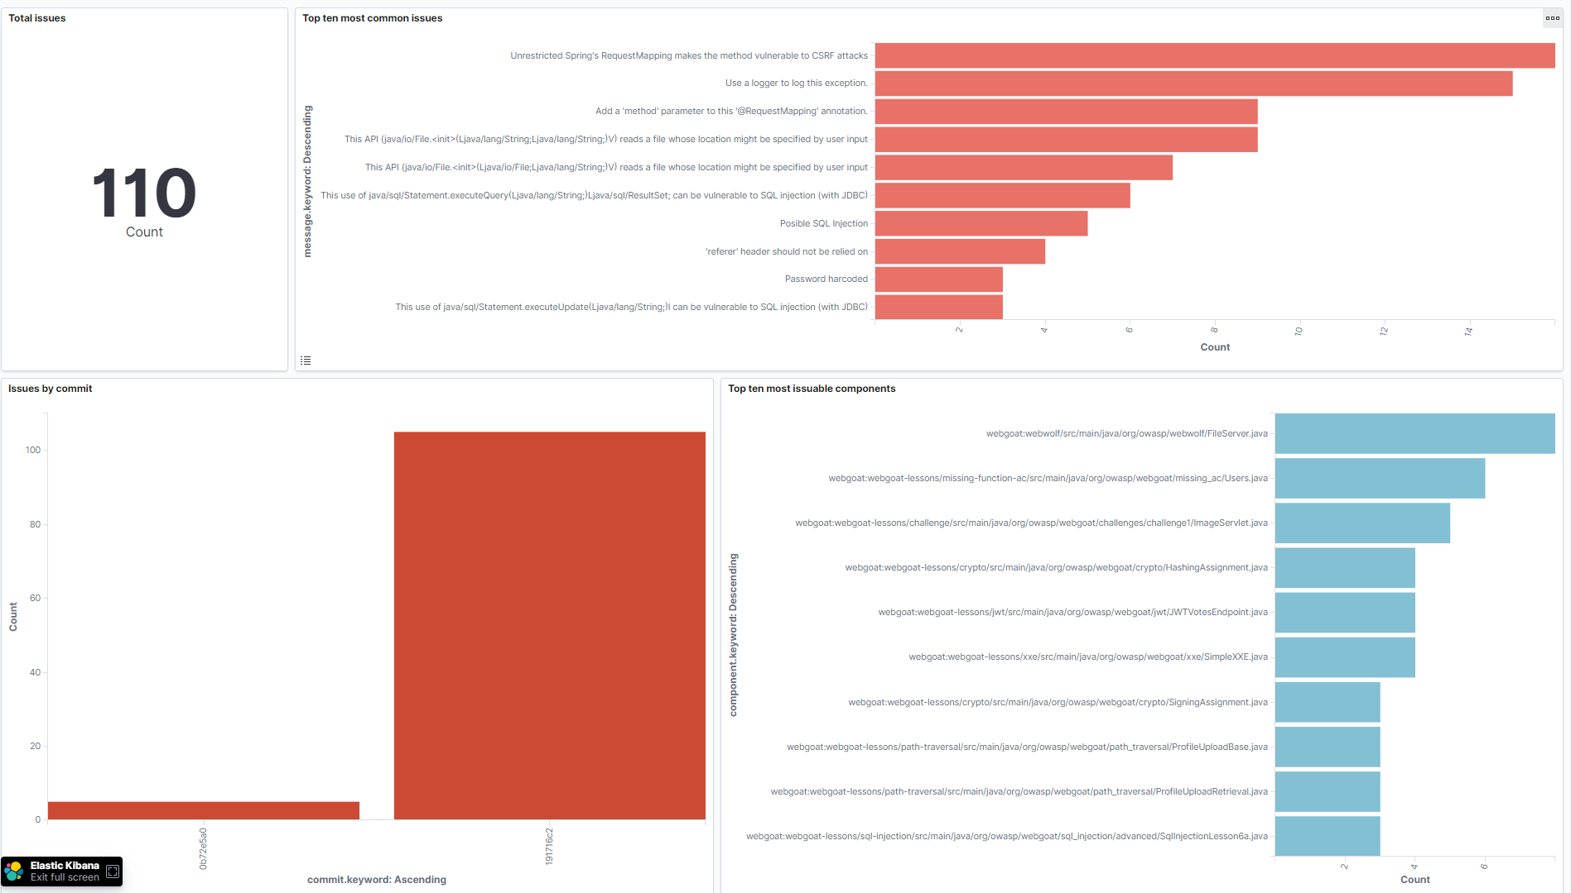
Dashboards

Slide 8
Dashboards

Slide 9

Vulnerabilities workflow
When a vulnerability is found, it will be created as “new” if it does not exist in the database for the current pipeline and branch.
New

Slide 10
Vulnerabilities workflow
If the vulnerability exist, the previous state must be checked.
Usually, the vulnerability will keep the previous state.
For example if the vulnerability is confirmed, it will continue to be confirmed.
New
New
Confirmed
Confirmed
Rejected
Rejected

Slide 11
Vulnerabilities workflow
Only for solved vulnerability, a new vulnerability will be created
Solved
New

Slide 12


Vulnerabilities workflow
Deloitte operators will confirm or reject the “new” vulnerabilities.
New
Rejected
New
Confirmed

Slide 13
Vulnerabilities workflow
For the next scan, the vulnerabilities that are in the database but not does not appear in the new scan, will keep its state for the following states
Solved
Solved
Rejected
Rejected

Slide 14
Vulnerabilities workflow
For the next scan, the vulnerabilities that are in the database but not does not appear in the new scan, the state must be changed to “New-Verify”.
This state must be checked by Deloitte operator, in order to verify a possible fix.
Confirmed
New-Verify
New
New-Verify

Slide 15
Vulnerabilities states
New
Rejected
Confirmed
New-Verify
Solved
A new vulnerability is created
The vulnerability is a false positive
The vulnerability is confirmed
The vulnerability could be fixed
The vulnerability was solved
The vulnerability is pending for review
Deloitte operator will check, and confirm the fix
Deloitte operator confirmed the fix
Deloitte operators will confirm or reject it

